Slide 1
Review of Basic Text Visuals
﻿live_A_simple_wordcloud.R
﻿live_B_comparisonCloud_bankLoans.R
﻿live_C_RapSongs.R

Slide 2
Let’s make some pyramids

Slide 3

Steps for a pyramid plot…collapse
Combined/Collapsed
into a 2 document corpus
CorpusA – 1000 Tweets
Clean & Collapse
CorpusB – 1000 Tweets
Clean & Collapse

Slide 4
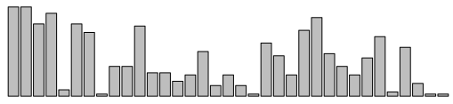
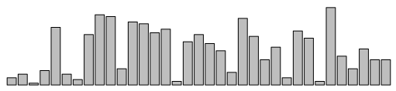
Steps for a pyramid plot…ID common tokens & frequency

Slide 5
Build a “pyramid plot” of frequencies
termA
termB
…
TermN

Slide 6
Experimental Barbell plot
Z-Score/Standard Score
Less than Avg
Word Usage
Avg
Word Usage
More than Avg
Word Usage

Slide 7
Open ﻿live_D_Pyramid_BarBell_plots.R
EXAMPLE INTERPRETATION
British Airways use of “service” is average overall but used much more often for Ryan Air
“Bags” is used less than the avg word use for both
“Passengers” is used more often than avg in both

Slide 8
Lab/Homework
Day2_HW.R

